Slide 1
Object-Oriented Programming
Mr. Ali Haider
Lab Instructor
School of CS & IT
Institute of Management Sciences, Peshawar, Pakistan

Slide 2
History (brief)
Programming evolved from machine/assembly language → procedural programming (C, Pascal) → OOP.
Procedural programming organizes code as a sequence of steps/functions operating on data. As programs grew large, this became hard to manage — data was separate from functions, making code error-prone and hard to reuse.
Simula 67 (1967) introduced the first OOP concepts (classes, objects).
Smalltalk (1970s) fully developed OOP as a paradigm.
C++ (Bjarne Stroustrup, 1980s) brought OOP to mainstream industry by adding OOP features to C.
Later: Java, C#, Python adopted and refined OOP.

Slide 3
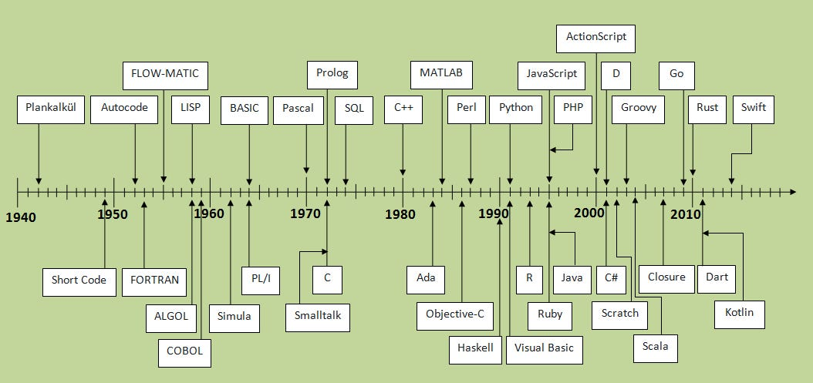

Slide 4
Procedural & Structured Programming
Early languages: Fortran, COBOL, Assembly
Focused on writing procedures/functions to operate on data
Problem: data and functions were separate — changes in one part often broke another, making large projects hard to manage
Emerged to fix procedural limitations: ALGOL, then C
Introduced loops, conditionals, modular functions
Improved readability/reusability, but data and functions were still separate

Slide 5
Birth of OOP
Breakthrough: Simula (1967) — first OOP language, introduced classes & objects
Smalltalk (1972) — fully embraced OOP; introduced inheritance & polymorphism as core principles
OOP Gains Traction
C++ (1983) – Bjarne Stroustrup; added classes/inheritance to C
Objective-C (1984) – Smalltalk-style messaging + C structure; basis of macOS/iOS dev
Eiffel (1985) – Bertrand Meyer; focused on reliability & maintainability

Slide 6
Mainstream Adoption
Java (1995) – Sun Microsystems; platform-independent, "Write Once, Run Anywhere"
Python (1991) – started procedural, added OOP early; known for simplicity
C# (2000) – Microsoft, part of .NET; influenced by Java, enterprise-focused
Hybrid languages (Python, Ruby, JavaScript) blend OOP with functional/procedural styles
Rise of design patterns for standardized problem-solving
OOP applied in web/mobile frameworks: Rails, Django, Spring, React

Slide 7
Criticism, Evolution & Future
OOP criticized as overly complex/rigid at times
Alternatives explored: Functional Programming (Haskell, Scala, functional features in JS/Python)
Aspect-Oriented Programming (AOP) — addresses cross-cutting concerns OOP struggles with
Still a dominant paradigm
Likely deeper integration with other paradigms
Emerging influences: metaprogramming, machine learning, concurrency

Slide 8
Enough for Today

Slide 9
Any Questions?

Slide 10
Thank You

